Slide 1
Vincent Van Gogh
By Joseph Barr

Slide 2
About Van Gogh
A self-portrait of Van Gogh, made in 1887
Was born on March 30, 1853 in Zundert, Netherlands and died on July 29, 1890 in France
Was an Art Dealer and Missionary before becoming an artist
Suffered from mental illness throughout his life
Was a Post-Impressionist Artist and helped the movement gain popularity
Used swirling and vibrant colors to display his emotions and thoughts
Had painted over 2,100 landscapes, still-lifes, and portraits in the last few years of his life
Was found of Oil-on-Canvas paintings and painted 810 Oil-on-Canvas works
Didn’t become world-renowned and famous until after his death

Slide 3
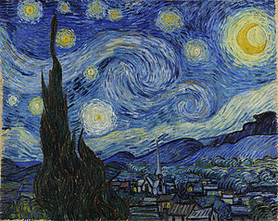
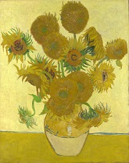
Two Artworks of Van Gogh
The Starry Night
Sunflowers
An Oil-on-Canvas painting made in 1889
An abstract landscape of the view out of a window in his house before sunrise with a fictionalized village in the foreground
Use of blues and yellows to color abstract swirls and stars in the night sky
Van Gogh’s most infamous work and one of the most famous and recognizable paintings ever made
A Oil-on-Canvas painting made in 1888
A yellow-tinted still-life of a pot of sunflower plants that was part of a two-series still-life project on sunflowers
Multiple versions and renditions of the painting were made by Van Gogh, the fourth one, shown above is the most well-known

Slide 4
Post-Impressionism
Created by Paul Cézanne and was a predominant art form from the mid 1880’s to the early 1900’s
Was a largely French movement and had a broad emphasis in abstraction and symbolism
Was created to combat the natural colors and loss of structure in Impressionist works
Post-Impressionists used vivid and abstract colors, applied excessive amounts of paint to their work, emphasized geometric shapes, and focused on real-life subject matter
The movement wasn’t unanimous and led to multiple offshoots such as Neo-Impressionism, Symbolism, Pointillism, and Synthetsim
There was no definite end to Post-Impressionism but it was followed by Modernism, Fauvism, and Cubism

Slide 5
Bibliography
https://en.wikipedia.org/wiki/Vincent_van_Gogh
https://en.wikipedia.org/wiki/The_Starry_Night
https://en.wikipedia.org/wiki/Sunflowers_(Van_Gogh_series)
https://en.wikipedia.org/wiki/Post-Impressionism

